Slide 1
CSC1003 Tutorial 1
Java Basic

Slide 2
TAs
BAN Lujie (班鲁杰) (Leading TA)
Email: 224040373@link.cuhk.edu.cn
Office Hour: Thursday 10:00 – 11:30 at TC 212
WANG Huizhong (王慧中)
Email: 224045005@link.cuhk.edu.cn
Office Hour: Thursday 10:00 – 11:30 at TC 212
LIANG Yuyang (梁雨阳)
Email: 119010174@link.cuhk.edu.cn
Office Hour: Thursday 10:00 – 11:30 at TC 212
ZHANG Shulun(张书纶)
Email: 225045020 @link.cuhk.edu.cn
Office Hour: Thursday 10:00 – 11:30 at TC 212

Slide 3
USTFs
YU Xinjie (俞信杰)
Email: 124090824@link.cuhk.edu.cn
MA Yuanqing(马源清)
Email: 124090467@link.cuhk.edu.cn
CHEN Ziqi (陈子琦)
Email: 123090059@link.cuhk.edu.cn
CHEN Xuluo (陈栩洛)
Email: 124090050@link.cuhk.edu.cn
GEOFFREY MIKHAEL
Email: 124040051@link.cuhk.edu.cn
HUANG Qianrong (黄千容)
Email: 124090221@link.cuhk.edu.cn

Slide 4
Overview
“GOOG1003”: How to use GOOGLE
Introduction to Java
Basic Syntax

Slide 5
GOOG1003
Disclaimer
This is not encouraging you to copy paste your homework
This is not encouraging you to skip classes
This is not encouraging you to stop learning and completely rely on internet
This is not encouraging you to think that TA is useless and you should report him

Slide 6
GOOG1003
Why use google?
Eﬃcient: You can almost get everything you want(for this course and the course you’ll ever take) from google.
Convenient: You can get the answer without waiting for TA to reply to you 10 hours later.
Convention: The knowledge and tools used by computer science are usually distributed in the form of websites or documents.

Slide 7
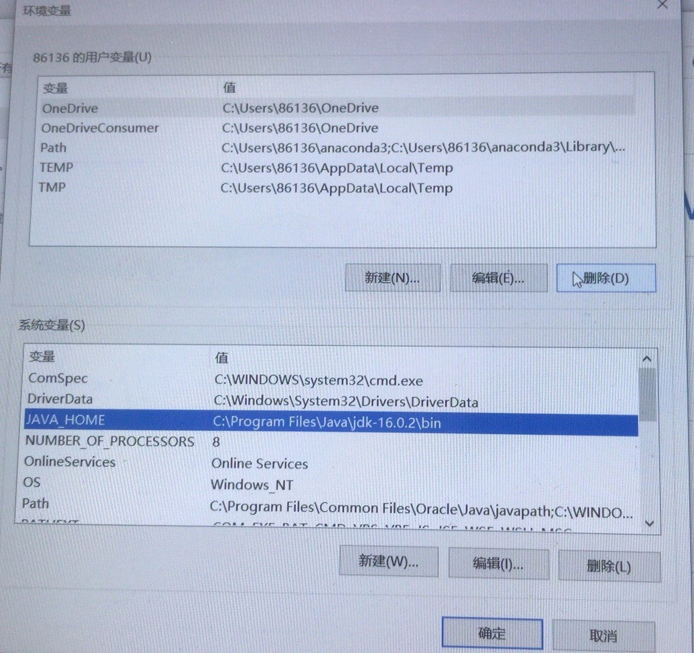
GOOG1003
Step 1: Formulate your problem
Q: Should I add ‘\bin’ in the ‘JAVA_HOME’ after ‘\jdk-16.0.2’

Slide 8
GOOG1003
Asked question: Should I add ‘\bin’ in the ‘JAVA_HOME’ after ‘\jdk-16.0.2’?
Real question:
How does the thing ‘JAVA_HOME’ works? /
How does the environment variable work on windows? / How can certain applications know that there is an environment variable and retrieve the information?

Slide 9
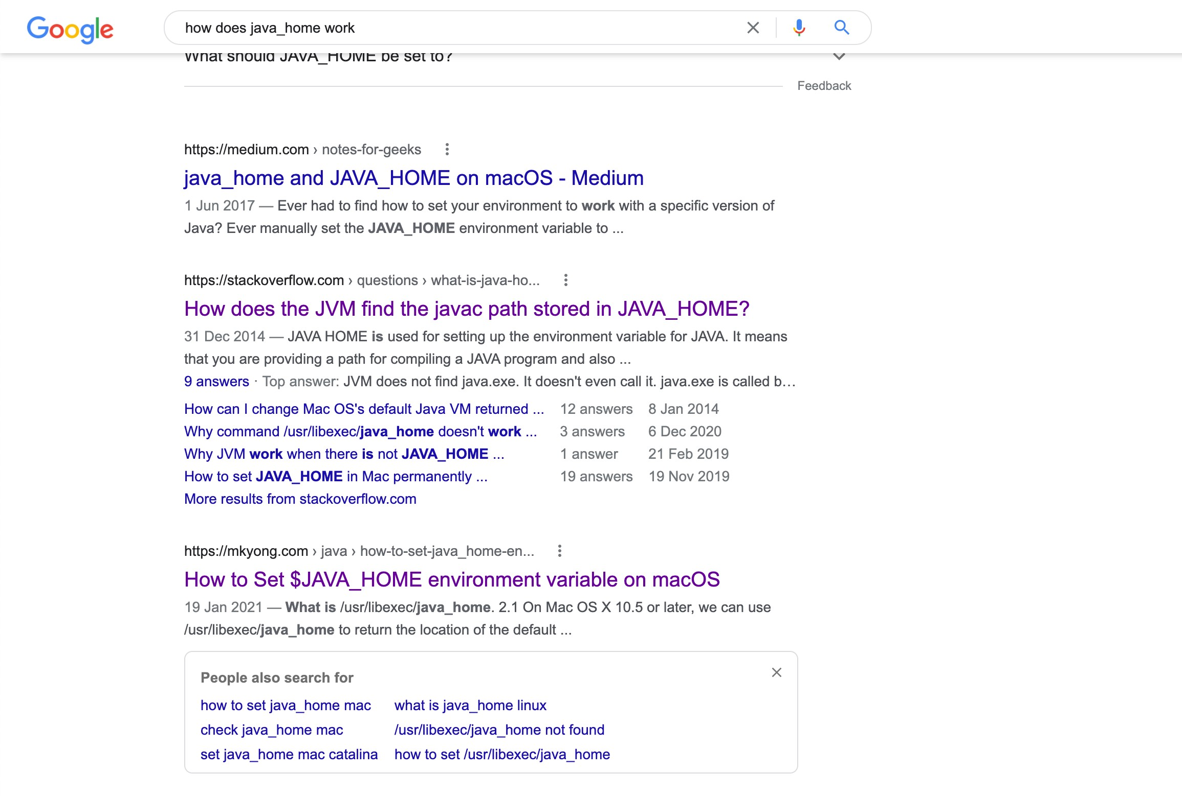
GOOG1003
Step 2: Search and choose reputable source

Slide 10
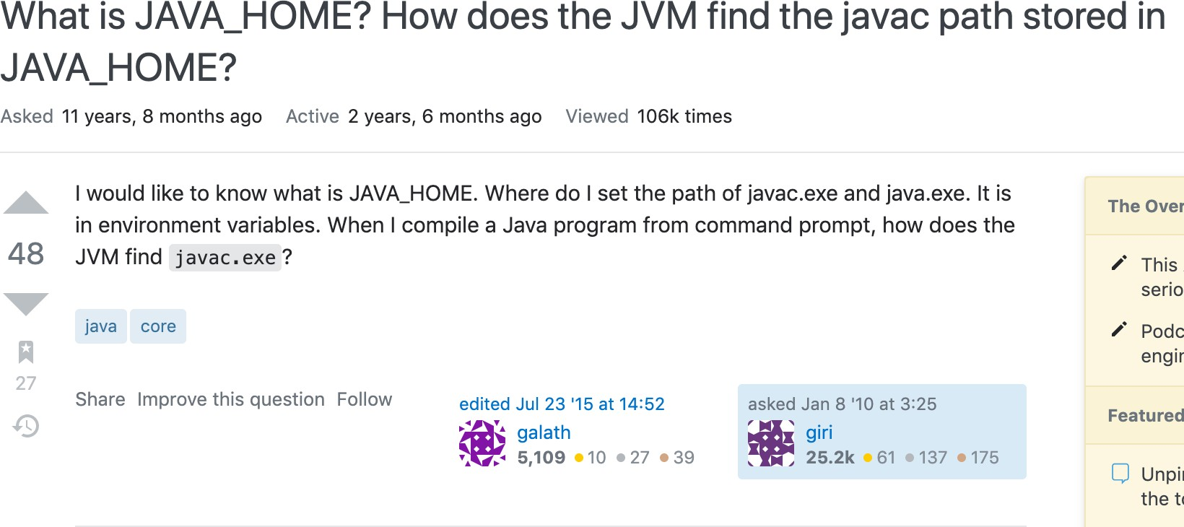
GOOG1003
Step 3: Read patiently

Slide 11
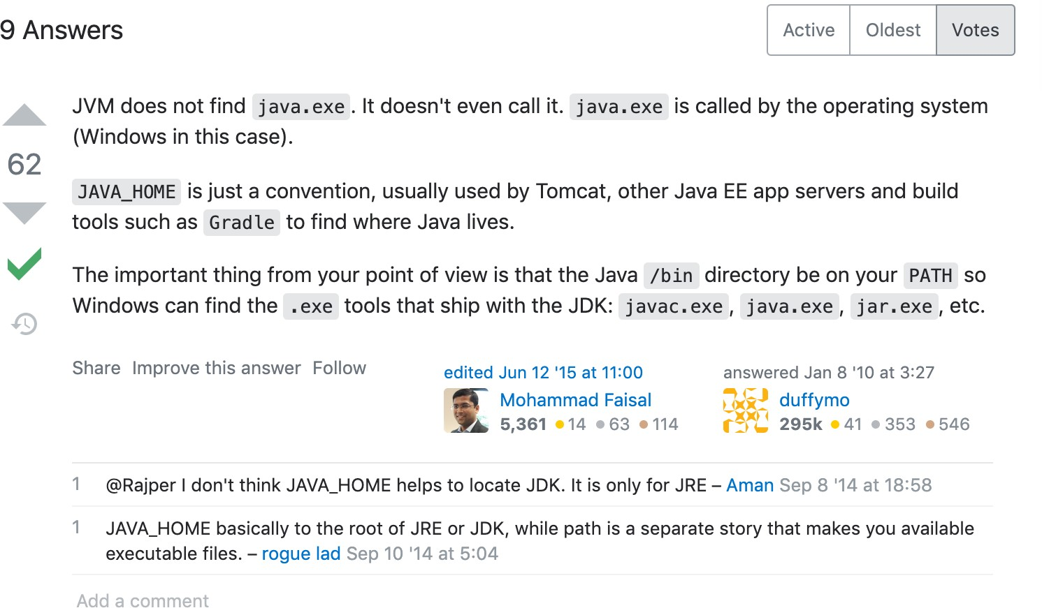
GOOG1003

Slide 12
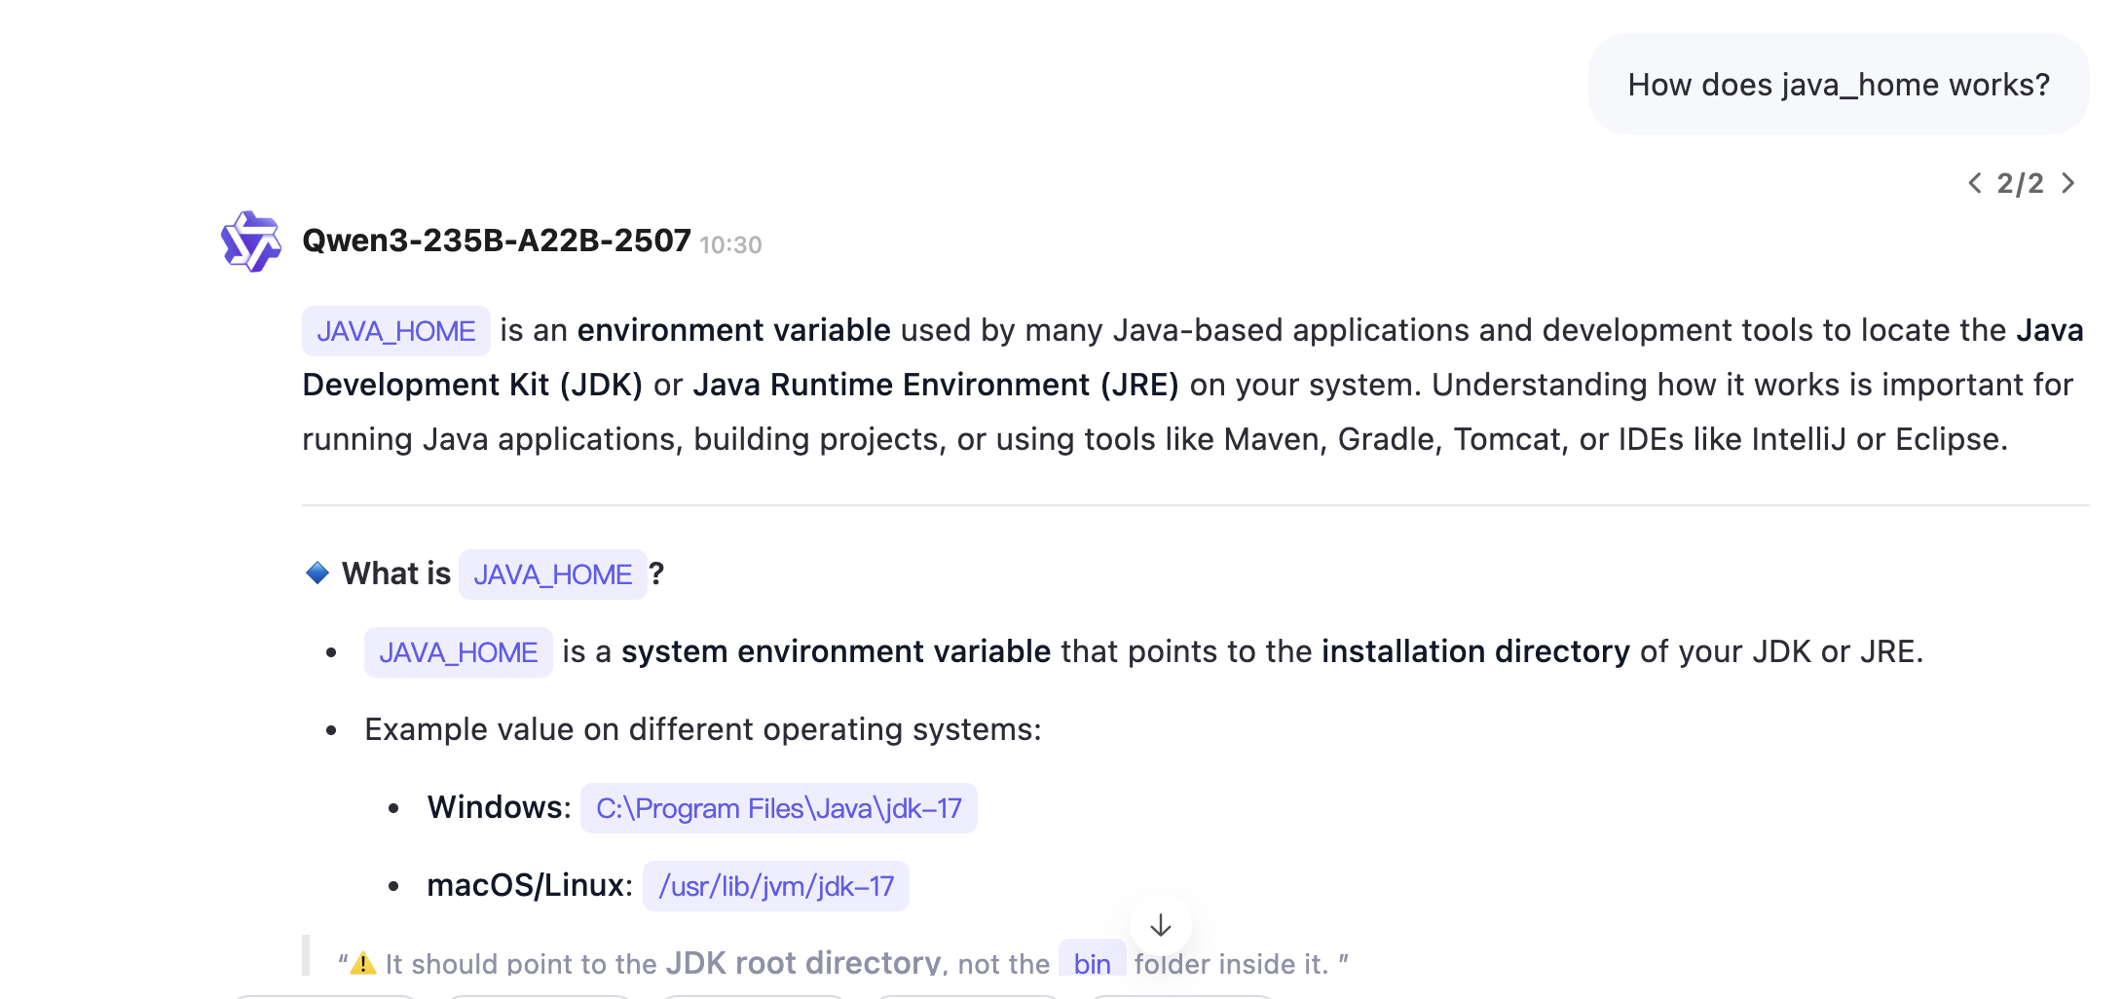
GOOG1003
You may also use Large Language Models (LLMs) to get the answer:
Be careful! The generated content may not be accurate.
The use of LLMs for completing coursework is prohibited！

Slide 13
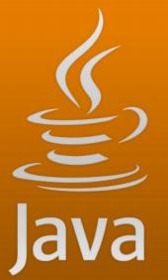
Introduction
What ’s Java?
is a programming language, similar to c++.
developed by James Gosling and his team at Sun Microsystems.
cross-platform running is the obvious advantage compare to C++.
first released in 1995 by Sun Microsystems.
Java 1.8 is released in 2014。

Slide 14
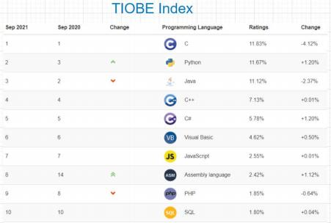
Introduction
• Where is Java used?
• Java is one of the popular programming languages and always top ranks.
• Some Applications
• Android： considered as the official language.
• BigData: the backbone for developing Big Data. many famous bigdata sorftwares are writen in Java:
• Hive,
• HDFS,
• Flink,
• etc.

Slide 15
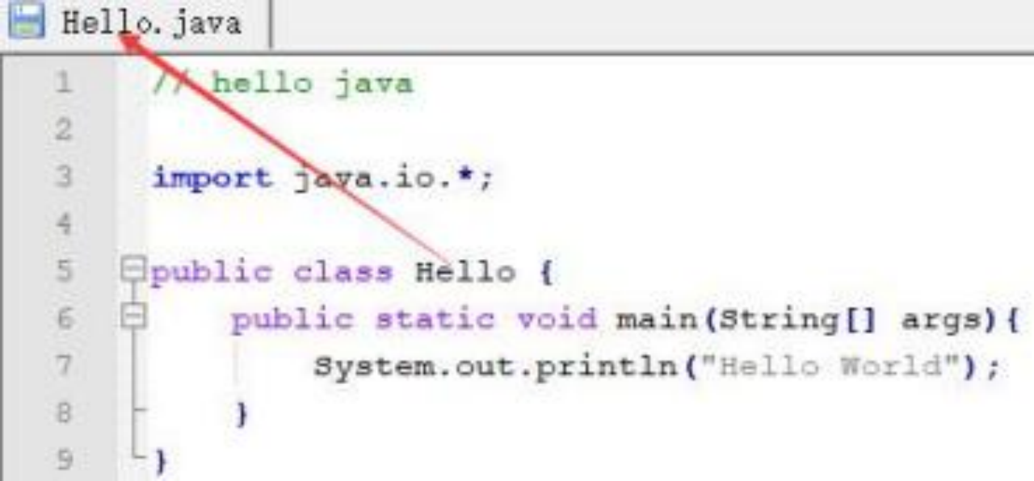
First Program
• Hello World Example：
• // represents a commented line.
• import java.io.* means all the classes of io
package can be imported.
• class is used to declare a class in Java.
• public means it is visible to all.
• static means there is no need to create an object to invoke the method.
• void means a method doesn't return any value.
• main represents the starting point of the program.
• String[] args is used for command line argument.
• System.out.println() is used to print statement on an output device like the computer screen.

Slide 16
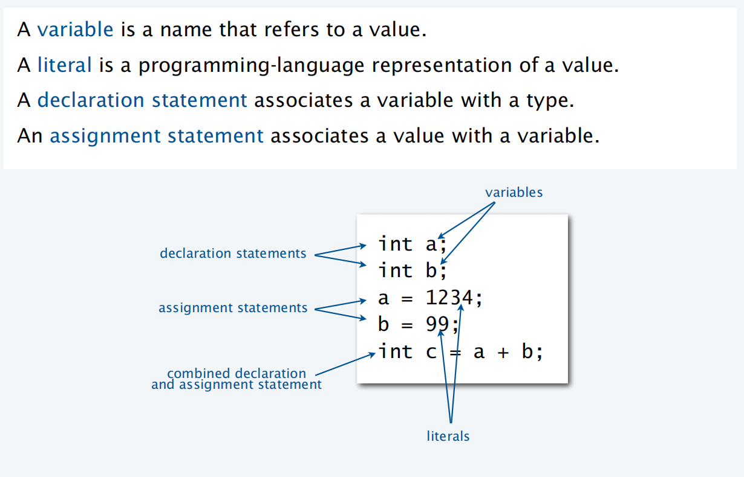
Basic Syntax

Slide 17
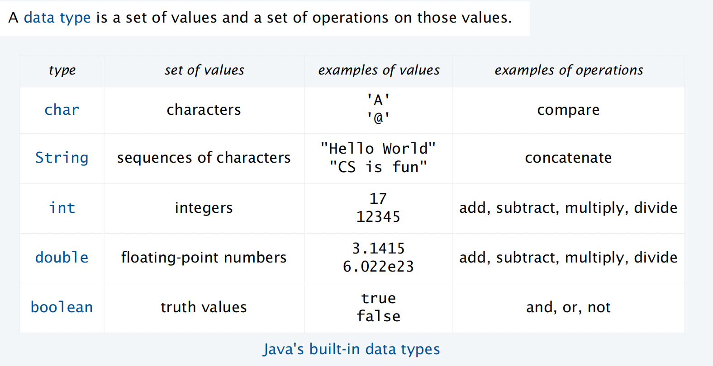
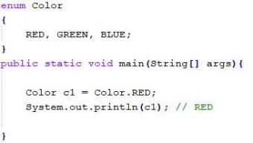
Basic Syntax
Extension:
other built-in numeric types:
short, float, long
non-primitive data types: class, enum, Interface, e.g,

Slide 18
Basic Syntax
Output
• System.out.println() method prints the given string.
• Java automatically converts numbers to strings for output.
Input using command line arguments
The usage of args[0], args[1]… in sample program of practice session
Require the parameters before you run the program
Input using `scanner` of `bufferedreader` e.g.
The usage of Scanner, scanner.nextInt() , scanner.nextLine()
Can be given after you run the program.

Slide 19
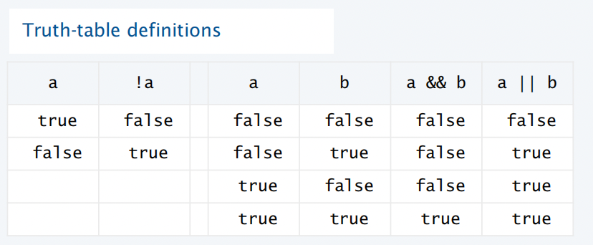
Basic Syntax
Computing for different data type
String: + (concatenate)
Int/Double: similar to math operations
Boolean: ! && ||
Comparison: similar to math comparison
note: != == =
i.e.:
a && !a
int a = 1; int b = 1;
System.out.println(a == b);
char a = ‘a’; char b = ‘a’; System.out.println(a == b);
4. String a = new String(“hello”); String b = new String(“hello”);
System.out.println(a == b);

Slide 20
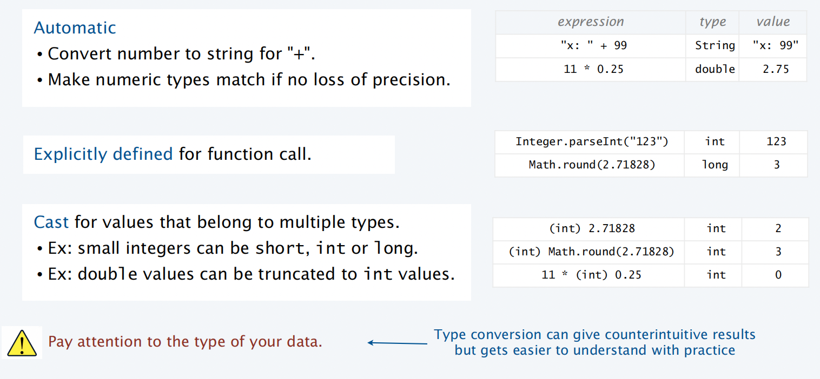
Basic Syntax: Type Conversion (tricky)
think:
(int) (11 * 0.25)

Slide 21
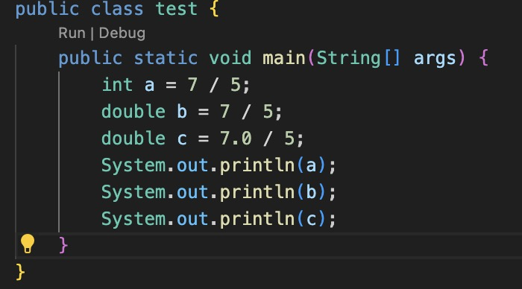
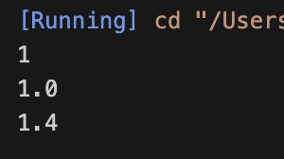
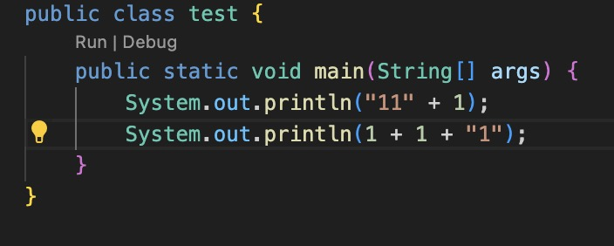

More examples:

Slide 22
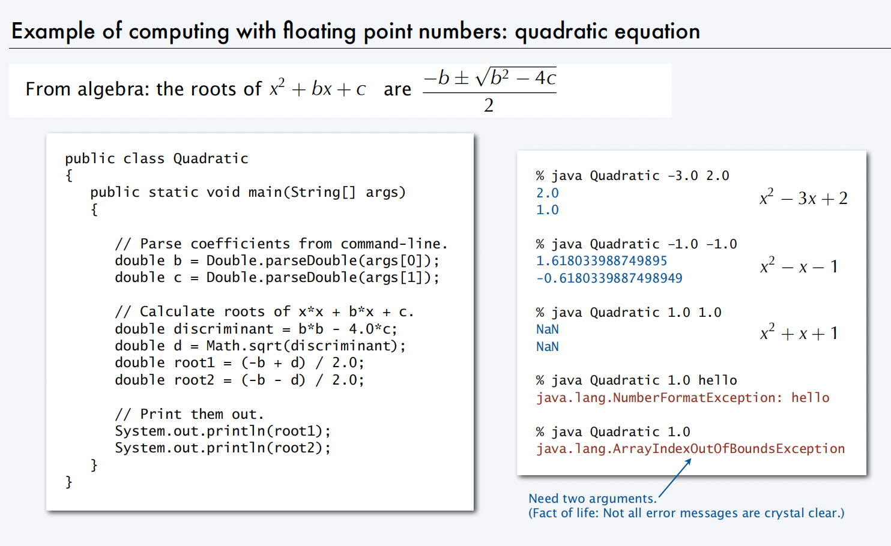

Slide 23
Reminder:
We will do JDK configuration and IDE installation in the practice session this week.
You will learn how to use OJ system in the practice session next week. (!important)

Slide 24
Q&A

